Slide 1
Slitherin Round
King Cobras
Kristen Mahoney and Kevin Harmer

Slide 2
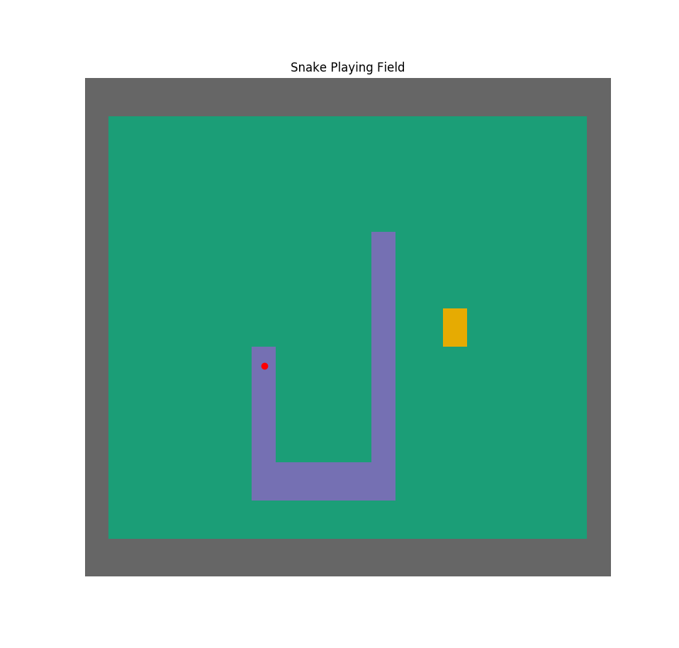
Snake Game
Developed for the Nokia 6110 phone
First major mobile phone game
How the Game Works
Snake grows and earns points with each pixel of food it eats
Four direction options to move
Win= snake fills entire field
Lose=snake hits its own body or a wall
Notes:
Considered the first major mobile phone game
I’m sure you’re familiar with the game or a similar version and might even remember your parents having this phone.
The rules of the game are fairly simple

Slide 3
Our Problem
Is there a guaranteed way to win the game?
If there is, what is it reliant on? Would it be dependent on the program parameters?
How long does it take? Are there quicker ways to win?

Slide 4
Related Works
Greg Surma implemented algorithms using domain specific solvers: bounded rectangle board
Shortest Path-Breadth First Search
Shortest Path- Depth First Search
Longest Path
Hamiltonian
Most successful
Depends on starting position and initial movement direction of snake
Gives snake an “escape route” unlike Longest Path
Notes:
Not a ton of mathematical work done on this topic, but these are two examples we found useful

Slide 5
Related Works
Tobin Ehlis used artificial intelligence to teach the snake how to win using tree and leaf methods.
tree=position of snake head
leaf= the possible movement options for the snake
Shu Kong and Joan Aguilar Mayans also made contributions to snake algorithms, which was characterized by their “Almighty Move:”
Similar to Hamiltonian, but not as successful
Always exist regardless of grid limitations

Slide 6
Our Method
Path Explorations
Hamiltonian
Shortest Path- Depth First Search
Almighty Move
Our Own Explorations: Sub-Hamiltonian
Results to Analyze
average score (which is number of food pieces eaten)
variation of score
score residuals
time statistics

Slide 7
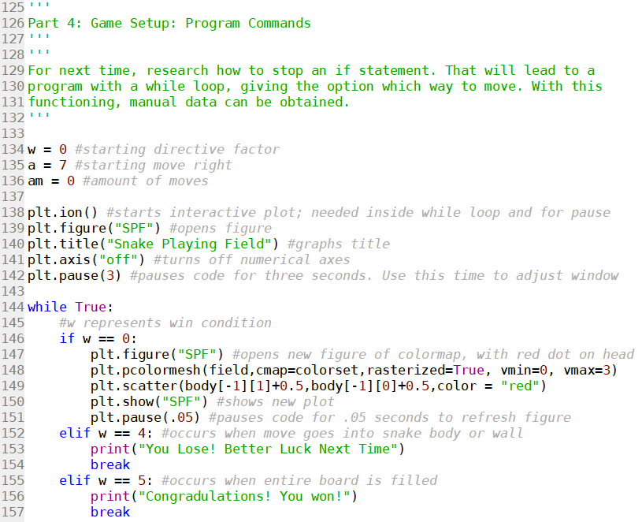
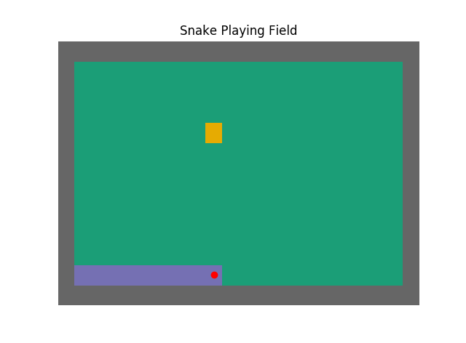
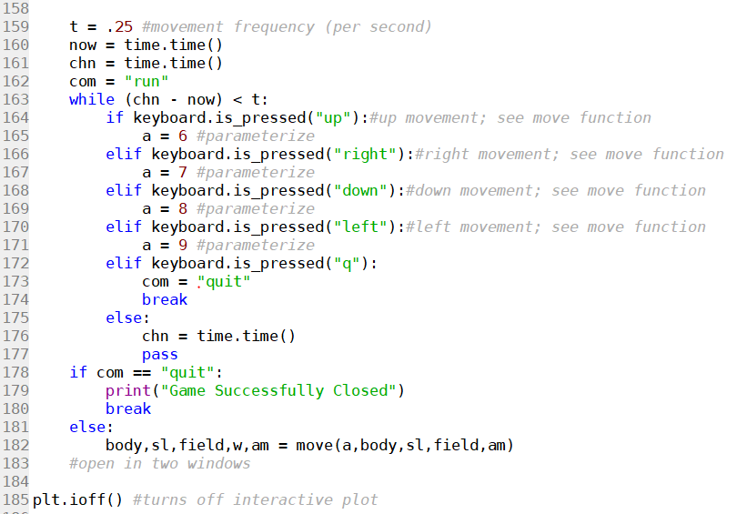
Some Code
Width = 20
Height = 11
Starting Length = 9
Starting Point = Bottom Left
Starting Field
Field after some gameplay

Slide 8

The Shortest Path: Depth First Search

Slide 9
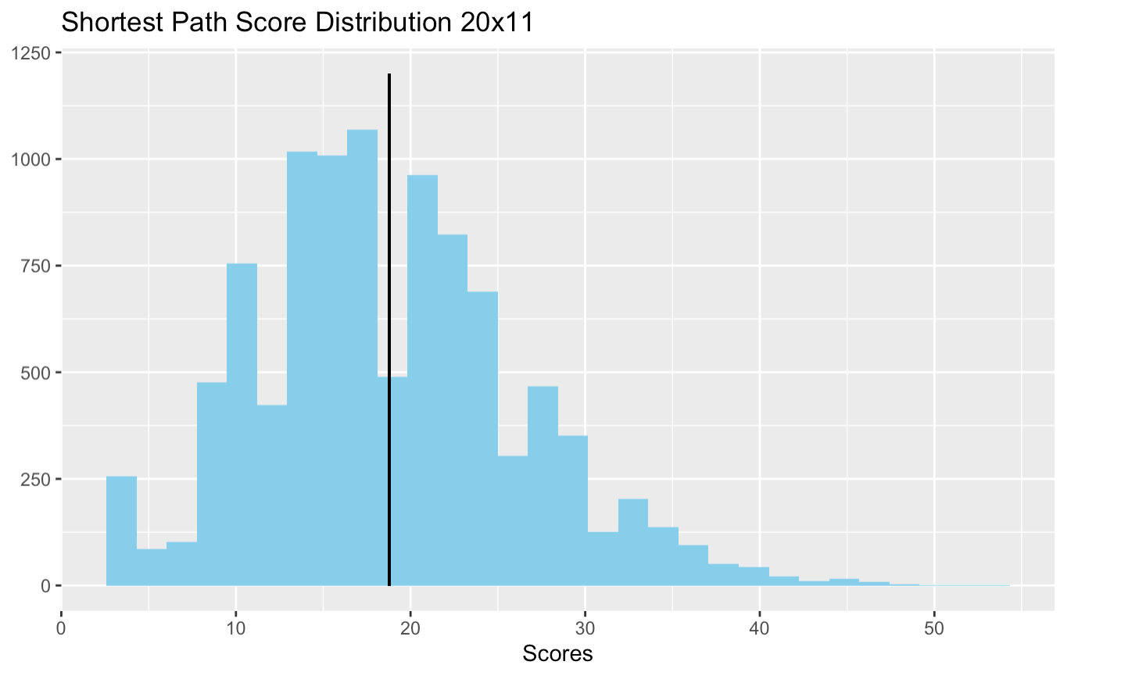
Shortest Path- Depth First Search 20x11
10,000 simulations in Python
Score Distribution
Positively skewed
Mean = 18.8, Median - 18.0
Maximum Score: 54 out of 220

Slide 10
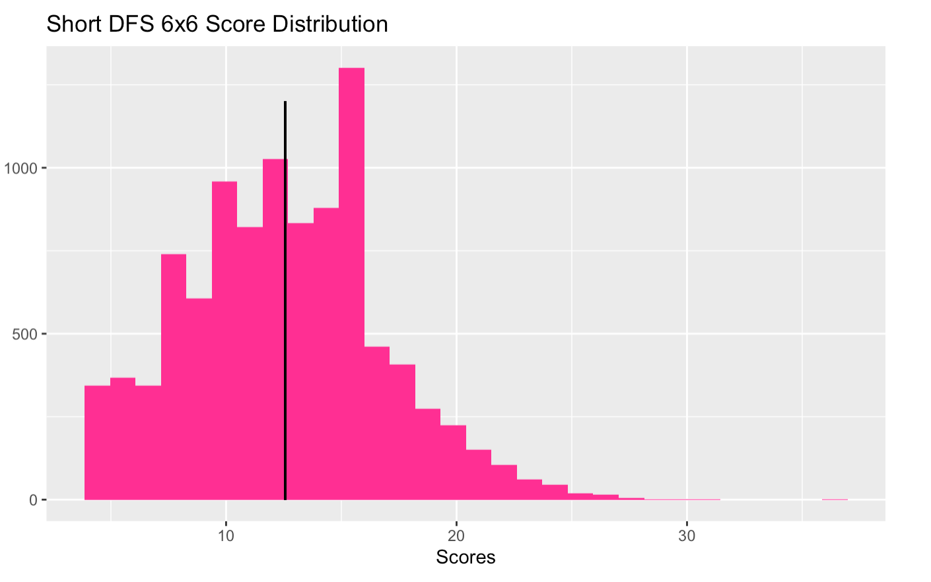
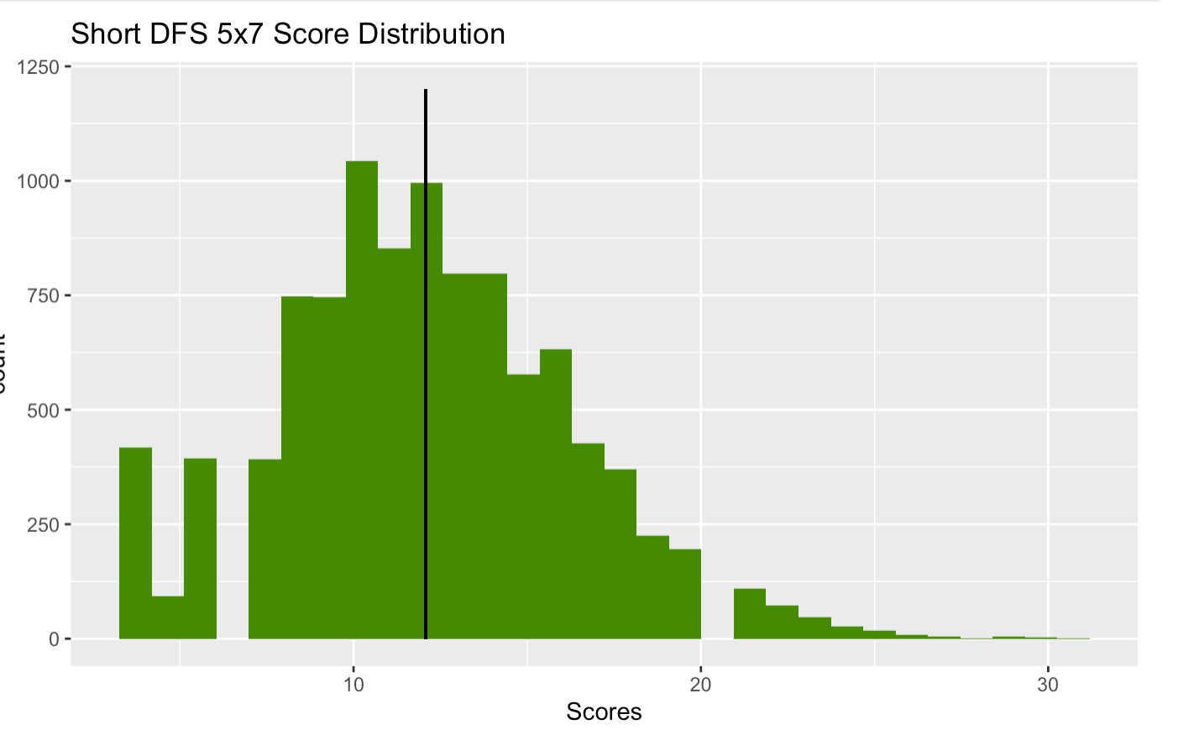
Sensitivity Analysis: Dimensions of Field
Only the 6x6 achieved a winning score of 36, and this happened two times.
This method and dimensions only has a 0.02% success rate.
The number of moves is directly proportional to the time it takes to win the game.
Winning simulations took an average of 151.5 moves, or 45.45 seconds.
The 5x7 never won a game. The closest it came was a score of 31.
Notes:
Is it more important to show the move distribution or the score??

Slide 11
The Hamiltonian Method
Characteristics:
Series of exact “cycles” that continuously repeat
Predefined method that maps node transitions over an entire cycle
Hits every node once and only once per cycle
Each cycle has the same critical point, which is where the cycle begins and ends

Slide 12
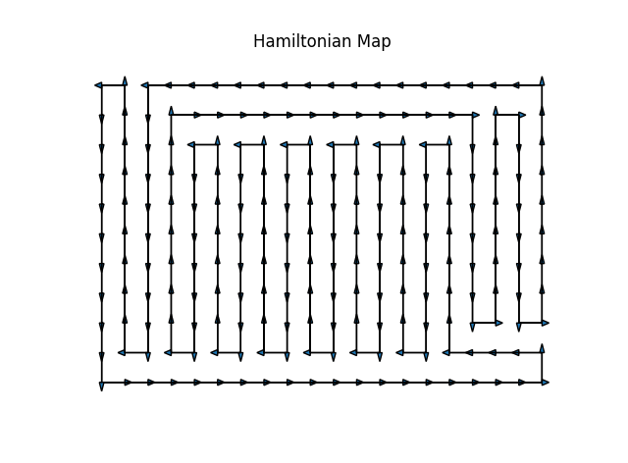
What the Hamiltonian looks like

Slide 13
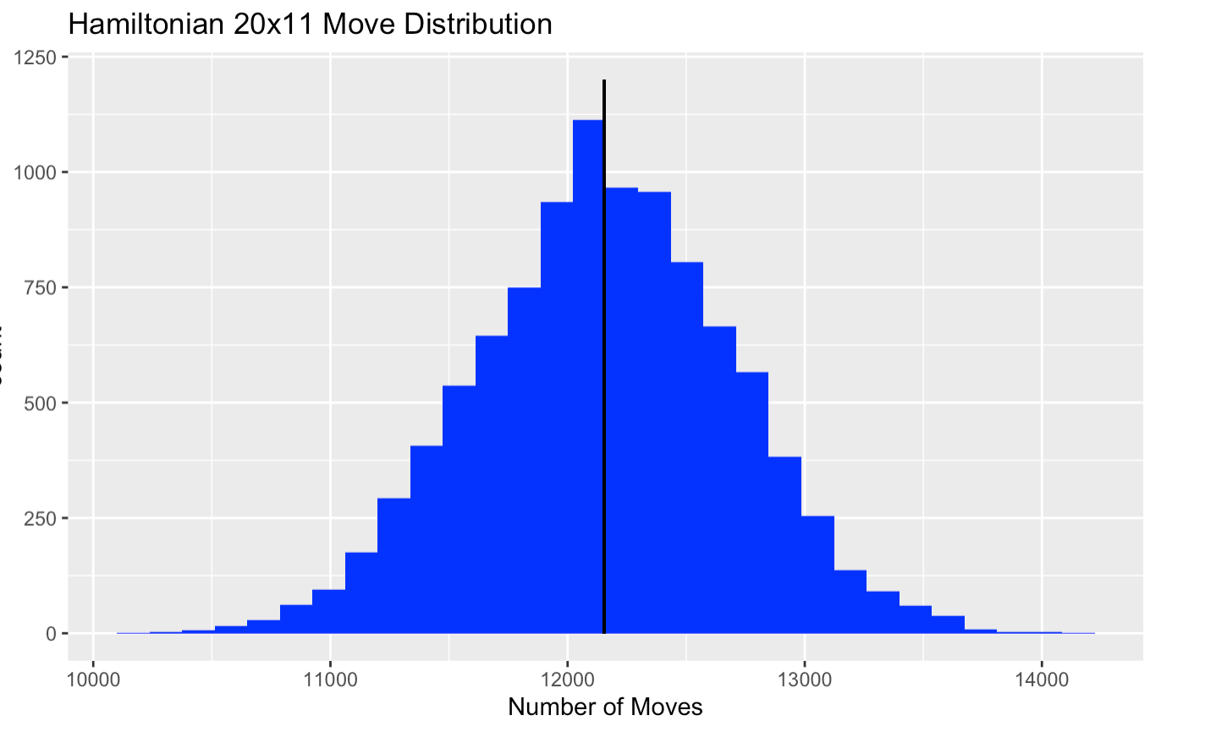
Hamiltonian 20x11
Every trial produced a winning result on a 20 x 11 field, unlike the shortest path approach.
Histogram shows distribution of number of moves needed to win.
It is practically a normal curve.
With an average of 12,155 moves, this method on 20x11 would take about an hour to win.

Slide 14
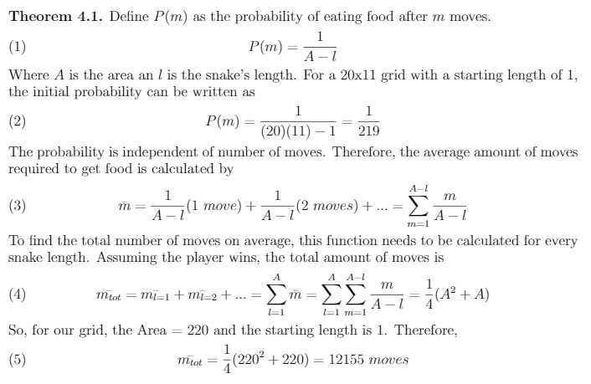
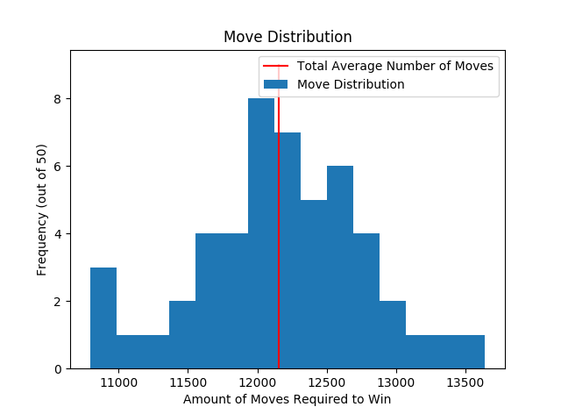
Move Probability Analysis (Example with 50 trials)

Slide 15
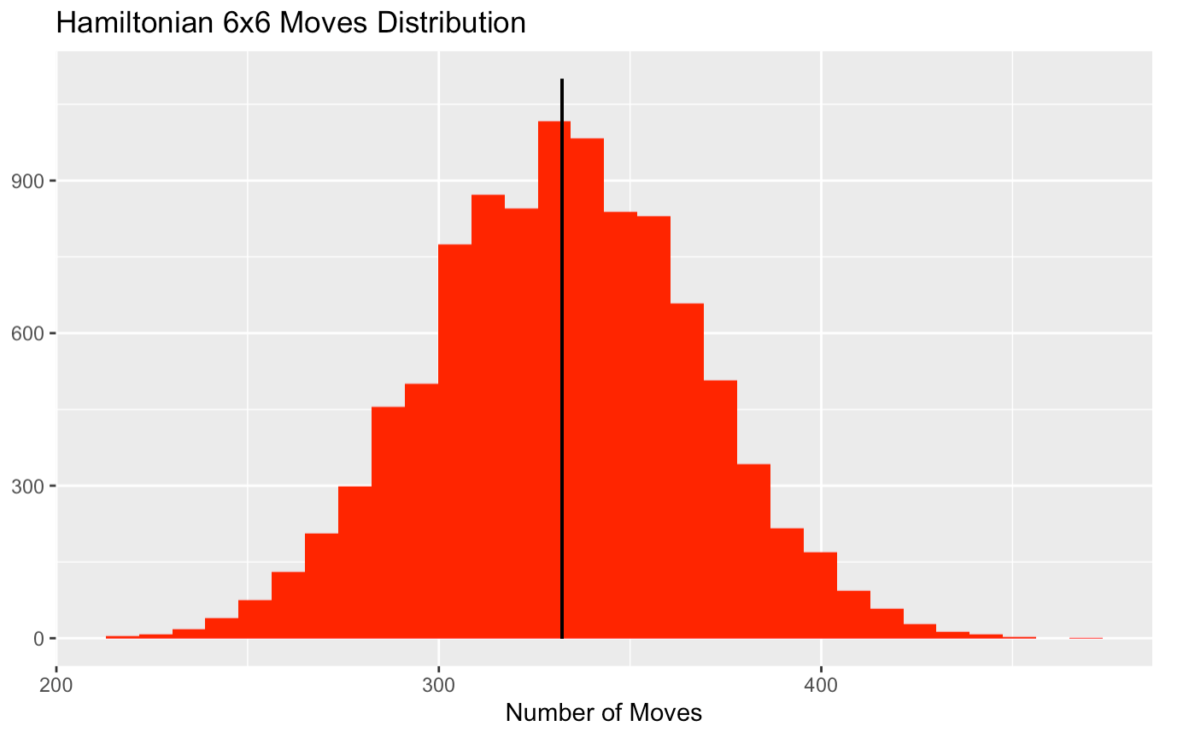
Sensitivity Analysis: Dimensions of Field
Hamiltonian is 100% successful on a 6x grid.
On average, it takes the 20x11 snake 1 hour and 46 seconds to win the game, and it takes the 6x6 snake 1 minute and 45 seconds to win.
When it was successful, the shortest path was faster on a 6x6 by about a minute.
No data for odd by odd Hamiltonian grid.

Slide 16
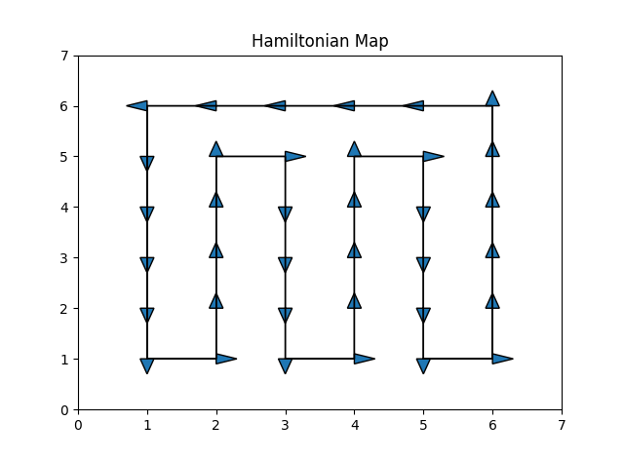
Grid Size Conjecture
Let A be an nxm rectangular lattice with n rows and m columns. If n or m are even, than a Hamiltonian Cycle exists.
Proof: Let n be even. The vertices of A can be defined by their coordinates (n,m). Suppose the cycle starting point, (1,1) and the initial cycle of movements:
(1,1) (2,1) (2, m-1) (3, m-1) (3,1) (4,1)
This cycle can be repeated n/2 -1 times, ending at the point (n,1). Therefore, the vertices covering the area with length of 2 to (n-1) and width of 1 to m-1, excluding the starting and endpoint. The endpoint, (n,1), can then move around the area and return to the starting point using the movement:
(n,1) (n,m) (1,m) (1,1)
Thus, closing the cycle and covering all the vertices, and completing the Hamiltonian Cycle.
If m is even, the same results can be obtained by a similar method with variables reversed.

Slide 17
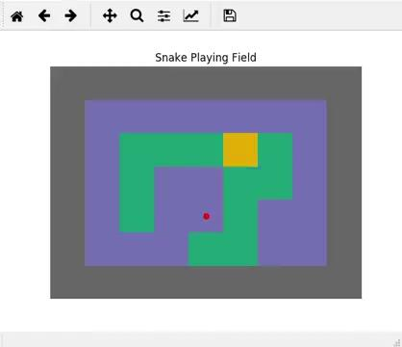
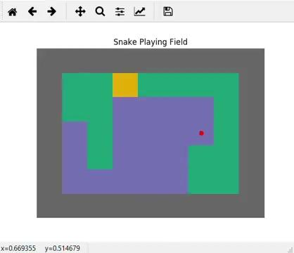
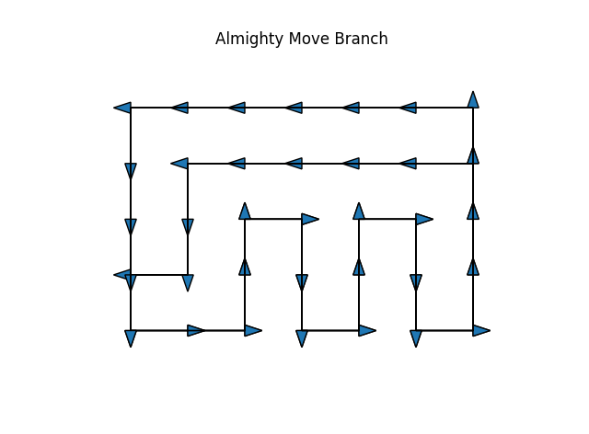
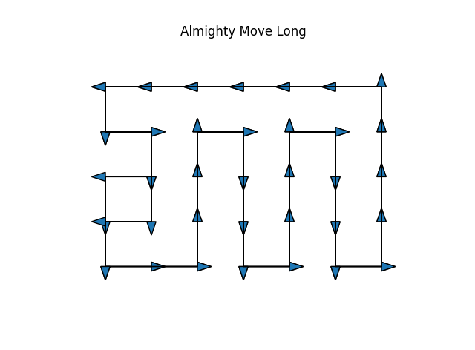
Consider 5x7 Grid: no Hamiltonian
Solution: Almighty Move
Branch Style
Long Style

Slide 18
Almighty Move 5x7
Adjust for the Hamiltonian failure on odd by odd grid
Branch: never won, max score of 33
Long: 37 simulations produced a winning score of 35.
9,963 produced a near perfect score of 34.
Winning stats comparable to Hamiltonian 6x6.
Method/Dimension | Almighty Long 5x7 (37/10,000) | Shortest 5x7 (never won) | Shortest 6x6 (2/10,000) | Hamiltonian 6x6 (10,000/10,000)
Avg. Moves | 335.2 | N/A | 151.5 | 332.3
Avg. Time | 1 min 41 sec | N/A | 0 min 46 sec | 1 min 45 sec
Notes:
What is the difference between the branch and the long
This is only for the games that hit 35. Should I just do the data for all of them though since it basically won?

Slide 19
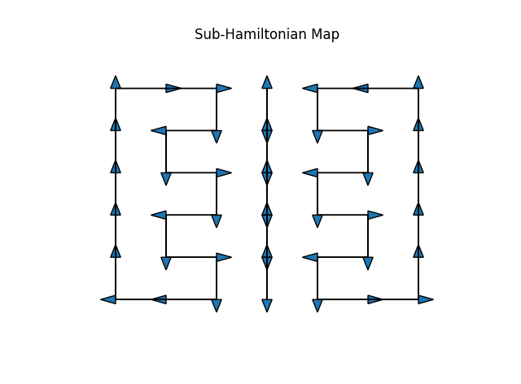
Our Own Method: Sub-Hamiltonian
(7x6 grid example)

Slide 20
Works Cited
[1] W. Alhalabi, O. Kitanneh, A. Alharbi, Z. Balfakih, and A. Sarirete,Efficient solution for
finding hamilton cycles in undirected graphs, SpringerPlus 5, (2016).
[2] T. Ehlis, Application of genetic programming to the snake game, Gamedev.Net, (2000).
[3] S. Kong and J. A. Mayans, Automated snake game solvers via ai search algorithms. https://cpb-us-e2.wpmucdn.com/sites.uci.edu/dist/5/1894/files/2016/12/AutomatedSnakeGameSolvers.pdf.
[4] Q. Myers, An oral history of ’snake’ on nokia).https://melmagazine.com/en-us/story/snake-nokia-6110-oral-history-taneli-armanto. [Online; accessed 03-08-2021].
[5] G. Surma,Slitherin-solving the classic game of snake with ai (part 1:Domain specific -
Shortest,Longestpath, hamiltonian cycle, dnn).https://gsurma.medium.com/slitherin-solving-the-classic-
game-of-snake-with-ai-part-1-domain-specific-solvers-d1f5a5ccd635. [Online; accessed 02-21-2021]

